Slide 1
Confederation of International Contractors' Associations Housing Working Group
CICA General Assembly 17-19 May 2022
Tel Aviv – Israel
Edwin Chirivi
Colombian Chamber of Construction - CAMACOL

Slide 2
Areas of work
Housing affordability
Energy efficiency and climate action

Slide 3
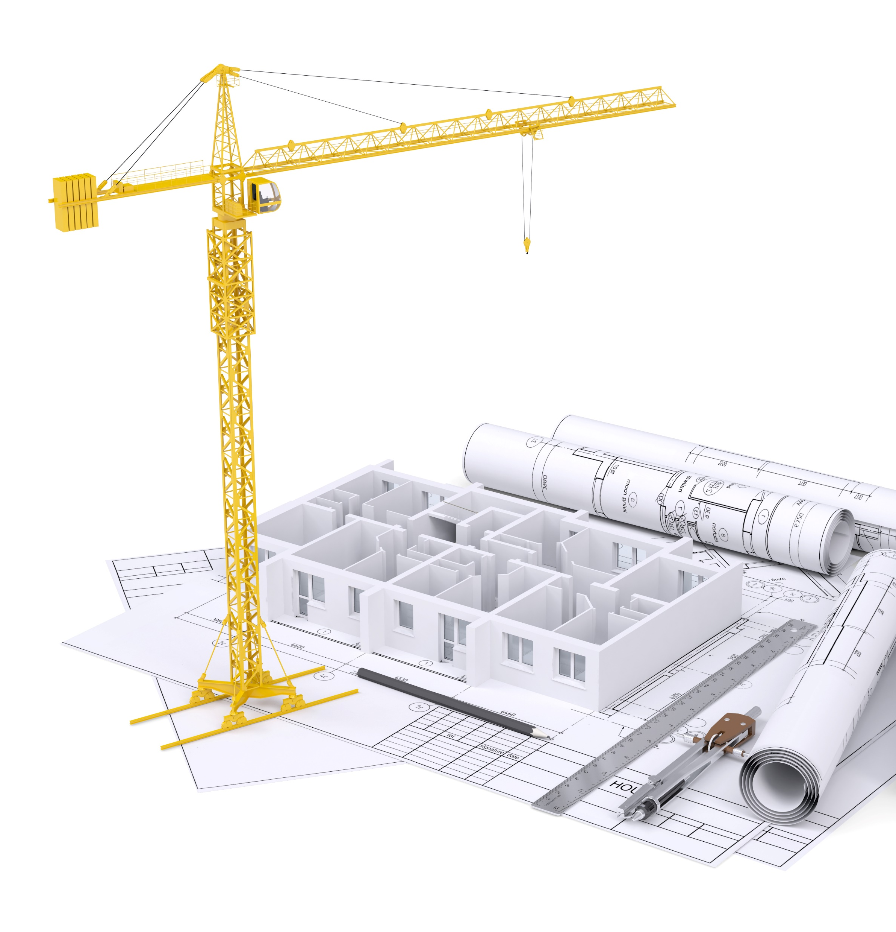
Main topics defined for the upcoming agenda
Affordable housing
Tax regimes
Demographic transition
Acctions for sustainability
Urban planification

Slide 4
Housing Working Group
CAMACOL is going to lead the Housing Working Group, and the upcoming agenda
The working group will held a meeting, every three weeks, and at least, once a month. Experts from different entities can be part of the sessions.
Main objective: doing a working paper/report about the importance of housing sector in the economic and social spheres (B20 Summit, november 2022), and including the development of the topics discussed and in meetings with MDBs
The main stream of the discusion will be about the housing affordability and energy efficiency/climate change, gathering the topics and inputs previously defined in the Group. Sharing information and researches about them is also part of the strategy

Slide 5
Confederation of International Contractors' Associations Housing Working Group
CICA General Assembly 17-19 May 2022
Tel Aviv – Israel
Edwin Chirivi
Colombian Chamber of Construction - CAMACOL

